Slide 1
Cornerstone City Church Peninsula Plus Community Hoo Are Ya
22-10-2023

Slide 2


Slide 3
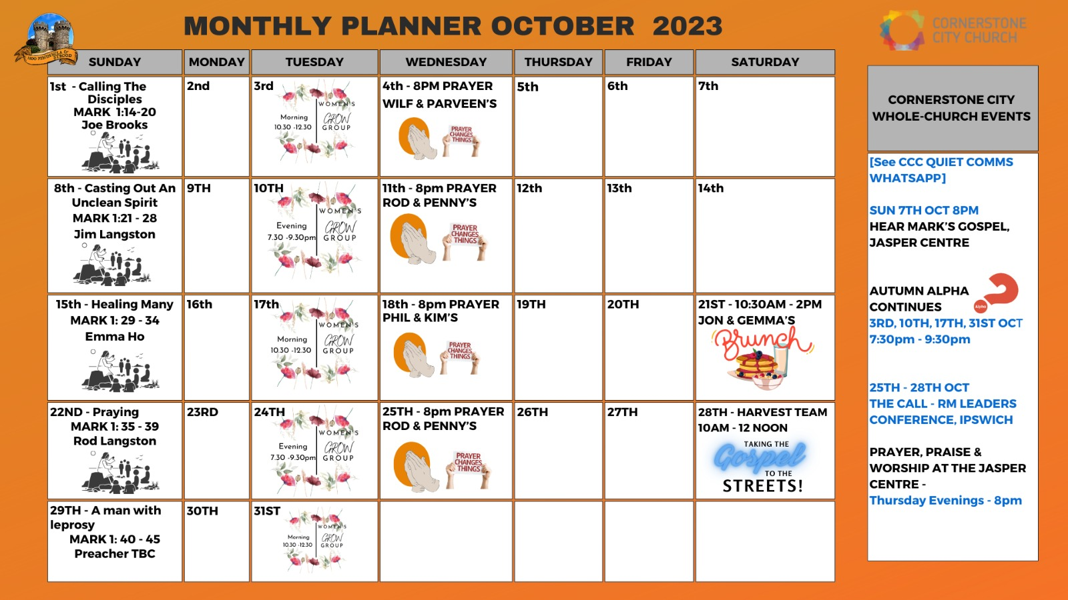

Slide 4


Slide 5
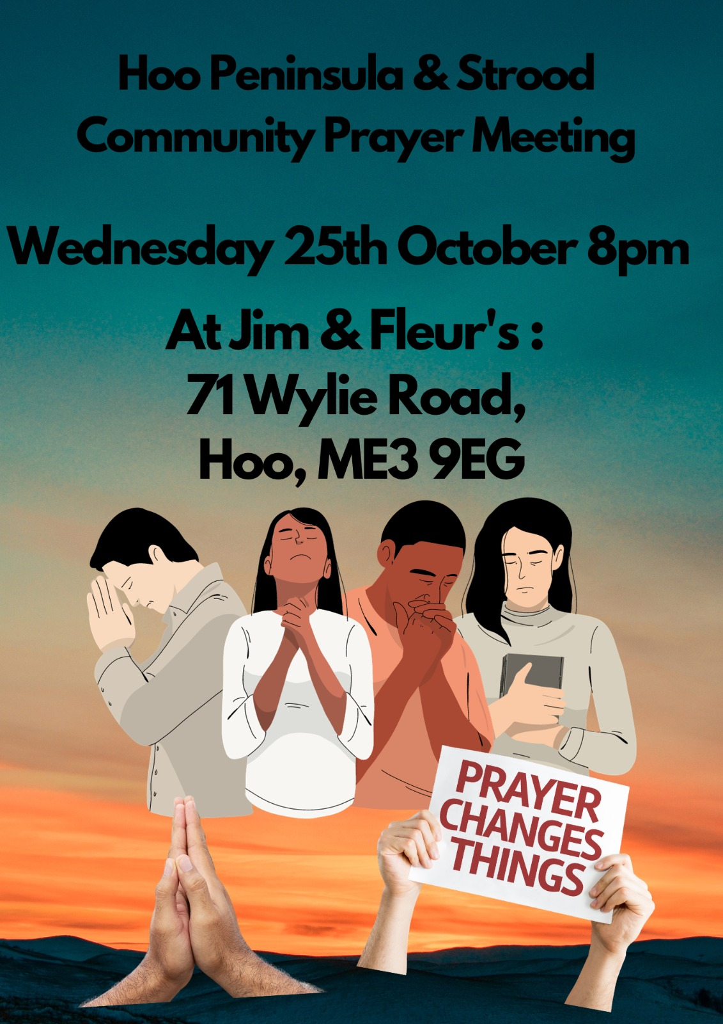

Slide 6


Slide 7


Slide 8


Slide 9


Slide 10
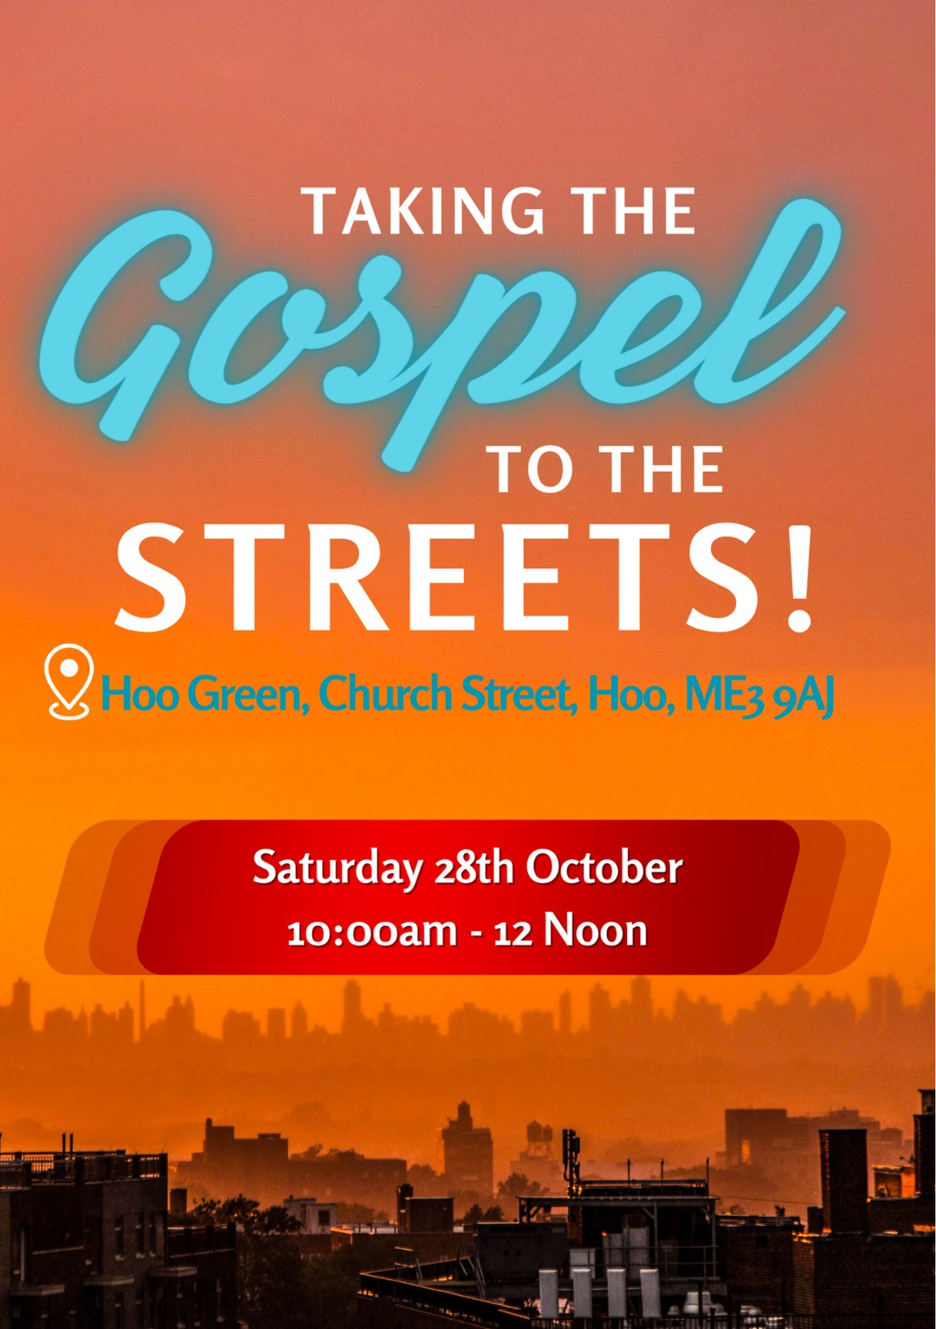

Slide 11


Slide 12


Slide 13


Slide 14


Slide 15
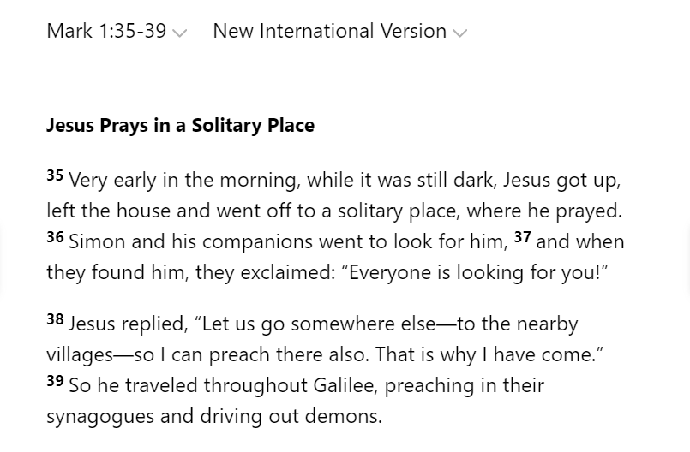

Slide 16
Despite the busy-ness of the previous day, Jesus rose “very early in the morning” to PRAY.
What was HIS motivation? What motivates us to pray? How do we pray? Why is this hall a good environment to pray?

Slide 17
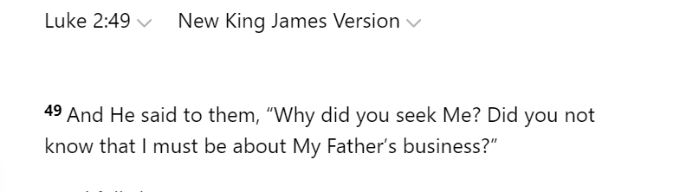
What was HIS motivation?

Slide 18
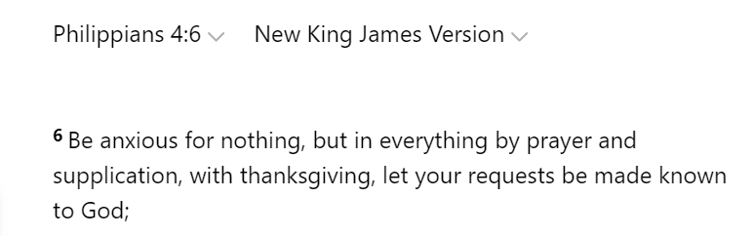
What motivates us to pray? Scripture tells us to pray "without ceasing... at all times... in everything... continually"
(1 Thessalonians 5:17-18, Ephesians 6:18, Philippians 4:6 and Hebrews 13:15).

Slide 19
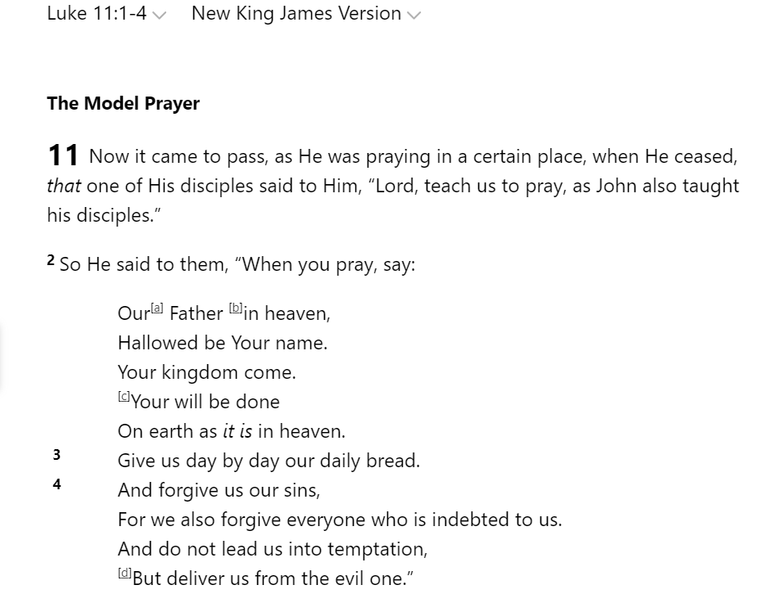
How do we pray?

Slide 20
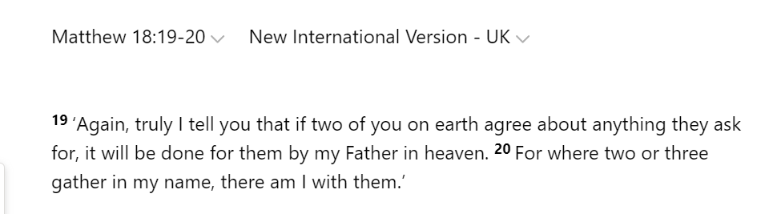
Why is this hall a good environment to pray?

Slide 21


Slide 22
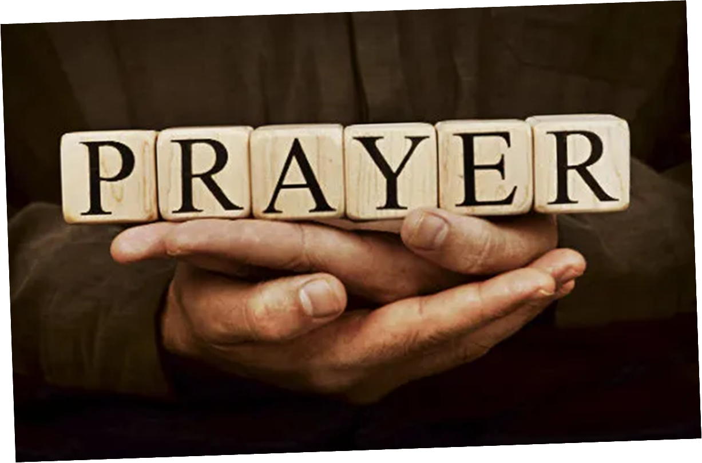

Slide 24
2 Corinthians 14 May the grace of the Lord Jesus Christ, and the love of God, and the fellowship of the Holy Spirit be with you all

